Slide 1
360i Roundtable Discussion

Slide 2
Understanding, Developing, and Leveraging Analysis Concepts
Facilitator: Peter Van Reusel
Scribe: Edwin Van Stein

Slide 3
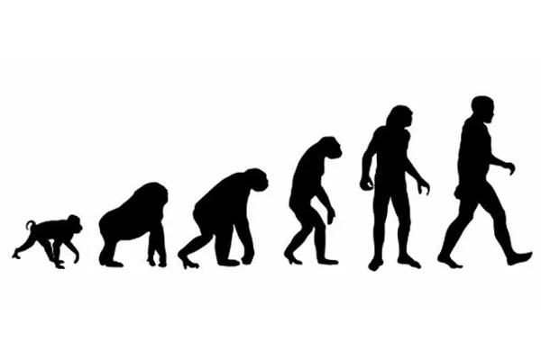
Analysis Concepts – Elevator Pitch
Missing link: structured metadata for describing analyses
Analysis Concepts aim to fill this gap:
Framework for expressing clinical questions > analysis data and results
Support the creation of a digital Statistical Analysis Plan (eSAP)
Inform programming logic for analyses
Analysis Concepts cover:
Handling of subject-level data prior to analysis (from SDTM to ADaM)
Analysis and creation of non-subject-level data (from ADaM to ARS)
Goals: interchange, automation and reuse of analyses, reduced ambiguity, increased traceability and streamlined collaboration

Slide 4
Roundtable Questions
How do you believe standardizing analysis concepts will help us advance automation and traceability?
What is the level of granularity we should define analyses while maintaining flexibility for the sciences?
At what level should we stop defining standards and only provide a framework? Conceptual layer vs. implementation layer
How do we make this understandable for a broad audience? Extending USDM to include everything or smaller standards that refer to each other?
How do we encourage the community to engage in this topic?
What education can we provide to help inform different stakeholders?

Slide 5
Summary of Breakout Sessions

Slide 6
Topic: Understanding, Developing, and Leveraging Analysis Concepts
Key Messages:
Need to show and demonstrate in a consumable manner
Circularity – protocol informs analyses, analyses inform protocol
Need feedback from industry – cannot predefine everything
Opportunities:
Tooling
Get authorities onboard early
Get industry onboard early
End-to-end digital TAUGs
Challenges:
Change management / push back
Timing: SAP needs to be more precise earlier

